Slide 1
Events portal 615 cloud management project
Nagul pandian, Immanuel odarteifio

Slide 2


AGENDA
Overview
Primary goals
accomplishments
limitations
SUMMARY

Slide 3

Overview
22,484 total student population.
65% undergrad 35% graduate students.
About 75 academic departments.
More than 300 student organizations.
At least two campus wide organizational fairs.

Slide 4
PRIMARY GOALS
WHAT WE WANTED THE PORTAL TO BE

Slide 5



Three main functionalities
Users to be able to rsvp for their desired event
Narrow down search results using key words
Departments can make postings for upcoming events

Slide 6
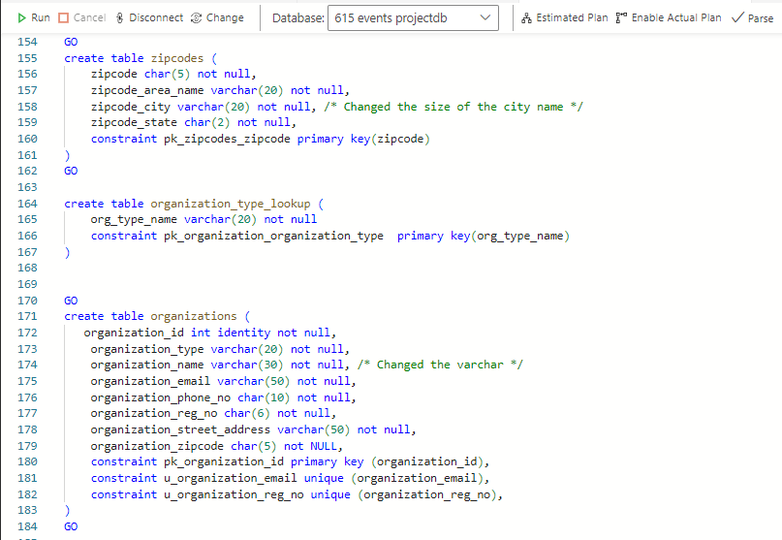
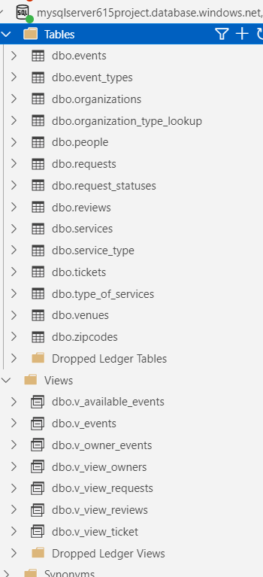
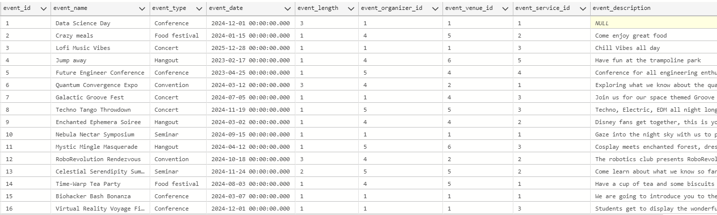
SQL Database
General purpose
Serverless
30 gb of storage

Slide 7
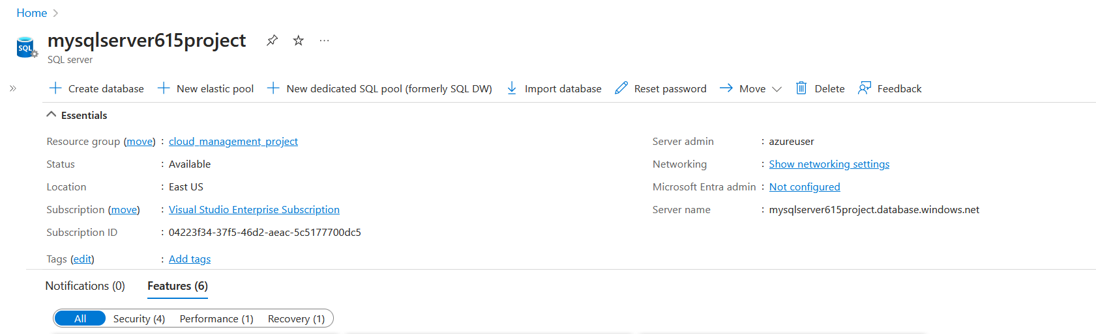
SQL server
To establish connection between the sql database and the web app

Slide 8
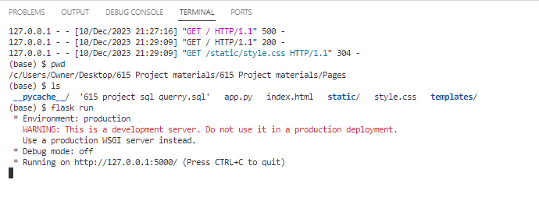
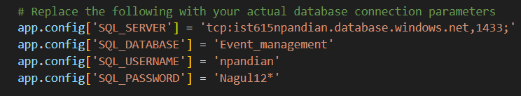
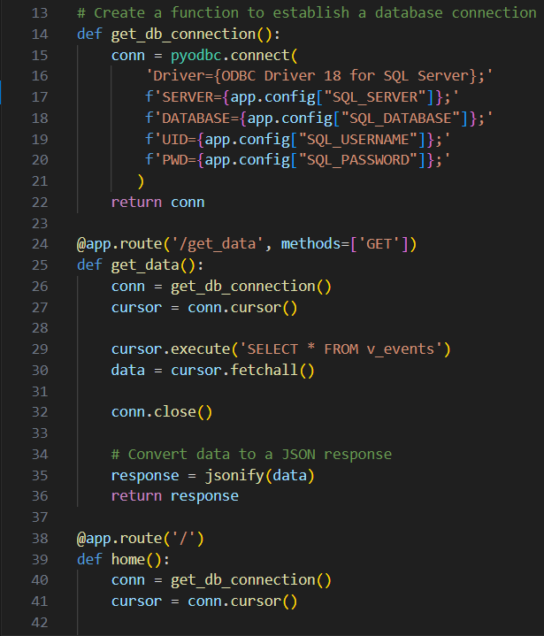
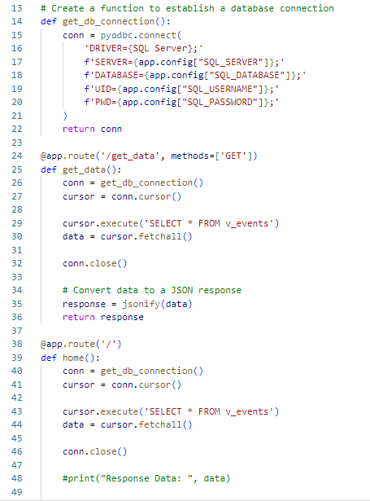
Python code
Used flask to host html code.
Established database connection to html page.

Slide 9
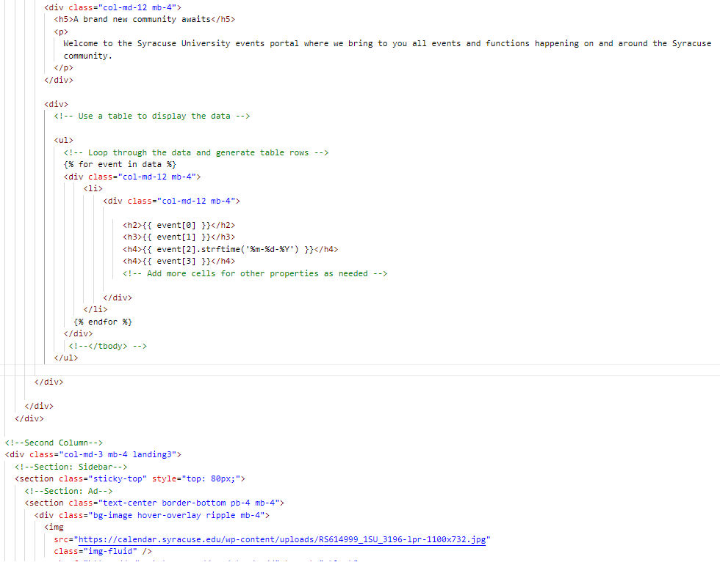
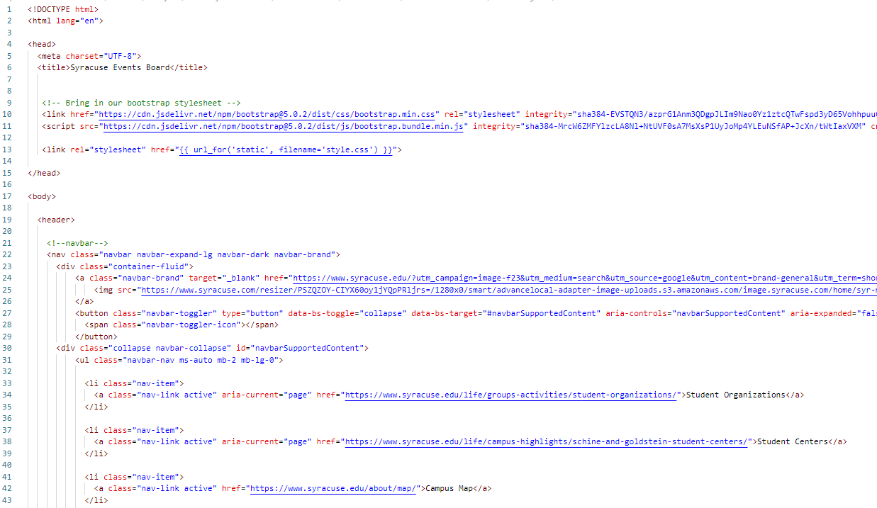
Html code
Landing Page

Slide 10
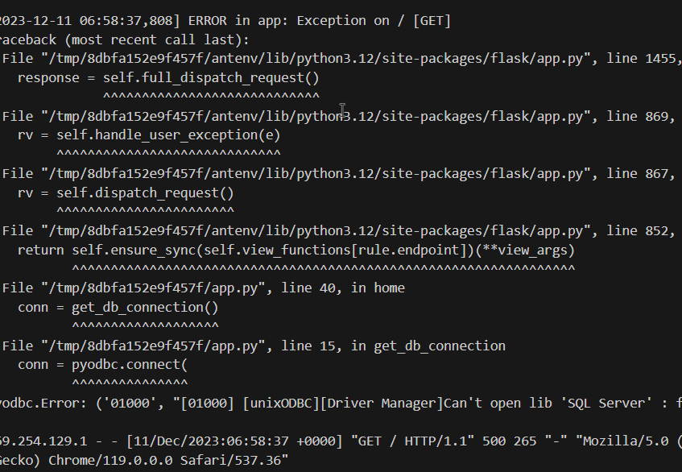
Azure app services
Azure AI search was too expensive about $250 per month
https://video.syr.edu/media/t/1_5fwmppym

Slide 11
Limitations
 | Sharing database connection due to IP addresses differences
 | Coding intensive ( flask, html)
 | Issue with the resource group
 | Service prerequisites

Slide 12
THANK YOU

